Slide 1
ANALYZING NEWS ARTICLES WITH TOPIC MODELING
B.SUJITH 21010126

Slide 2
CONTENT
INTRODUCTION
DATASET DESCRIPTION
DATA PREPROCESSING STEPS
TOPICMODELING WITH (LDA)
LDA WITH COUNT VECTORIZER
LDA WITH TF-IDF
FLOW DIAGRAM
COMPARING TWO MODELS
CONCLUSION

Slide 3
INTRODUTION
What is Topic Modeling?: It’s a technique to discover hidden themes in large collections of text.
Why is it important?: Helps in summarizing large sets of documents by identifying prevalent topics without human intervention.
Objective: Apply LDA to classify news articles into predefined categories (e.g., Sports, Politics).

Slide 4
DATASET DESCRIPTIONS
Structure: The dataset consists of three columns –Title, Description and Category.
Categories: The dataset covers five categories: Entertainment, Business, Tech, Politics, and Sports.
Size: There are 2.2k news articles in total, giving a sense of the data's scope.

Slide 5
Data preprocessing steps
Contraction expansion: Contractions (e.g., "can't") are expanded to their full forms (e.g., "cannot").
Lowercasing: All text was converted to lowercase to maintain consistency.
Removing punctuation, digits, whitespaces: Cleans unnecessary characters from the text.
Stopwords removal: Commonly used words (e.g., "the", "is") were removed because they don’t carry much meaning.
Lemmatization: Words were reduced to their base or root form (e.g., "running" to "run").

Slide 6
LDA with Count Vectorizer
Count Vectorizer: It simply counts word occurrences across all documents.
Show the top 10 words extracted from articles for a given topic (from the LDA model)
GridSearchCV results: Mention the best number of topics based on the grid search.

Slide 7
LDA with TF-IDF Vectorizer
LDA with TF-IDF Vectorizer : Focuses on words that are important to a document but less common across all documents, reducing the influence of overly common words.
Highlight the best model parameters from GridSearch for the TF-IDF-based LDA model.
Perplexity and Log Likelihood: Introduce these two scores to evaluate model performance. Perplexity measures how well a probability distribution predicts a sample, and log likelihood measures model fit.

Slide 8
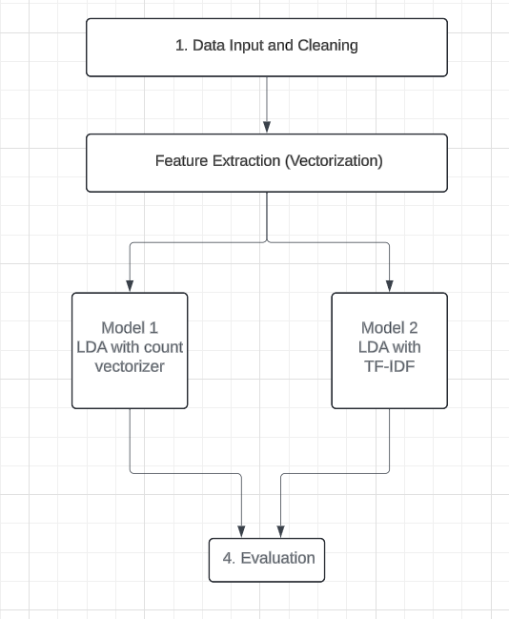
Flow diagram

Slide 9
CompaRING two models
Perplexity Score: Model 1 has a lower perplexity score, meaning it’s better at categorizing new, unseen data.
Log-likelihood Score: Model 2 has a higher log-likelihood score, which suggests it fits the training data better. However, this doesn’t always mean it’s the best at predicting new data.
Precision and Recall:
Model 1 generally has better precision and recall for most topics.
Model 2 does well in few categories but performs worse in other categories.

Slide 10
conclusion
The project was able to find topics in news articles using LDA (Latent Dirichlet Allocation).
Key Results:
Model 1 (LDA with Count Vectorizer) did better in accuracy, precision, and recall, making it more reliable for classifying articles.
Model 2 (LDA with TF-IDF) had a good fit with the data, but its accuracy was lower
Best Model:Model 1 is the better choice because it performs well across different measures.

